Slide 1
AI Assignment 2
Guru Rohith CS22B022
Sai Kowshik CS22B004

Slide 2
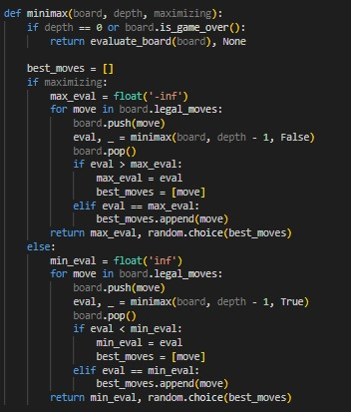
Minimax Algorithm : Minimax Implementation in Chess AI
Key Features:
1)Brute-force search of all possible moves up to depth 2
2) Recursive evaluation of board states
3) Random selection from equally valued moves
Evaluation Function:
Material count:
1)Piece values: Pawn=1, Knight/Bishop=3, Rook=5, Queen=9
2)Random noise: ±0.1 to break ties
3)Repetition penalty: -100 for 3-fold repeats
Performance Notes:
1)Guarantees optimal moves (for given depth)
2)Slower execution: Examines all branches
3)Stable but limited by shallow depth
Visual:
1) Game Play in next Slide
2)Code snippet of minimax() function

Slide 3
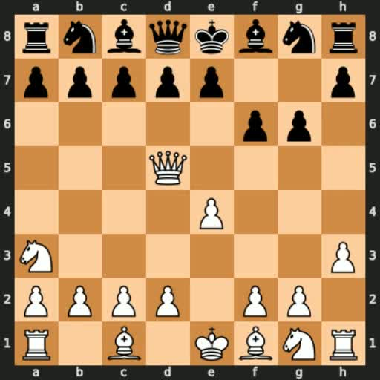
Game Play

Slide 4
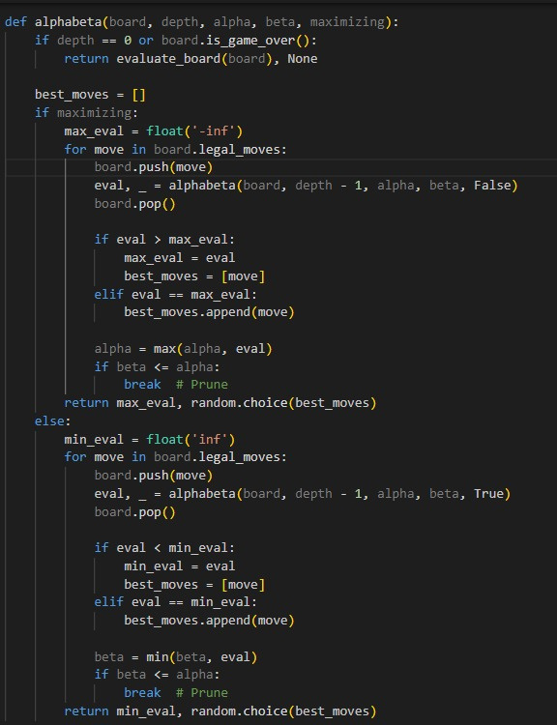
Key Features:
1)Prunes irrelevant branches (beta ≤ alpha)
2)Same evaluation as Minimax but faster
3)Depth-2 search with early termination
Optimizations:
1)Alpha (α): Best already explored for maximizer
2)Beta (β): Best already explored for minimizer
3)Pruning skips 30-50% of branches
Performance Notes:
1)Identical moves to Minimax at depth 2
2)Theoretically faster (though depth=2 hides gains)
3)Scalable for deeper searches
Visual:
1)Game Play in next slide
2)Diagram of pruned branches
Alpha-Beta Pruning : Alpha-Beta Optimized Chess A

Slide 5
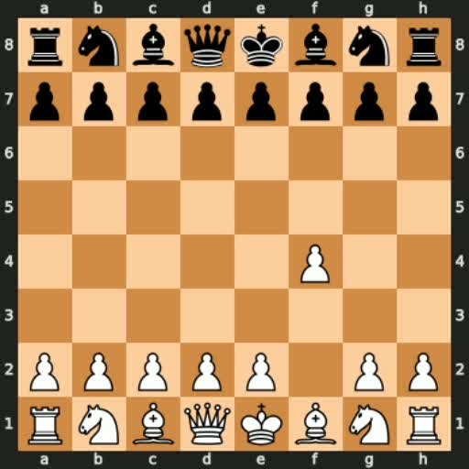
Game Play

